Slide 1

DIGITAL LOGIC DESIGN (111776)
Dr. Owais Hussain

Slide 2

Agenda
Combinational circuits
Exclusive gates
Gate conversions

Slide 3
Sample 2
Combinational Circuits
Digital electronics is divided into two major types of circuits
Combinational circuits
Work only on present input signals
Have no memory or feedback
Sequential circuits
Works on present as well as past input
Supports memory and feedback

Slide 4
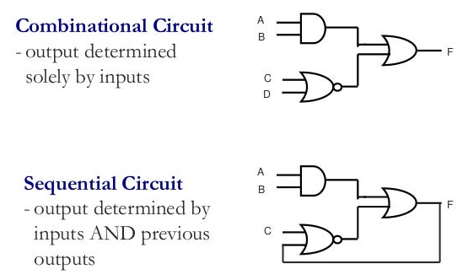
Sample 2
Combinational Circuits
Digital electronics is divided into two major types of circuits
Combinational circuits
Work only on present input signals
Have no memory or feedback
These are easy to implement and faster to operate
Sequential circuits
Works on present as well as past input
Supports memory and feedback
These are difficult to implement and slower to operate

Slide 5
Sample 2
Combinational Circuits
AOI, or AND-OR-INVERTER circuit is formed when the output of a SOP form is inverted. The AOI configuration lends itself to product-of-sums (POS).
Here is an example of an AOI circuit, which can be expressed as POS using DeMorgan’s theorem.
A
B
ABC
C
X = ABC
+ DE
X = ABC
+ DE
AOI
D
X = (ABC)(DE)
DeMorgan
E
DE
X = (A + B + C)(D + E)
POS

Slide 6
Sample 2
Combinational Circuits – Design steps
Determine the input variables
Make a truth table to define input states and their output
Use Karnaugh map to find out minimal SOP equation
Draw the logic diagram from the SOP equation

Slide 7
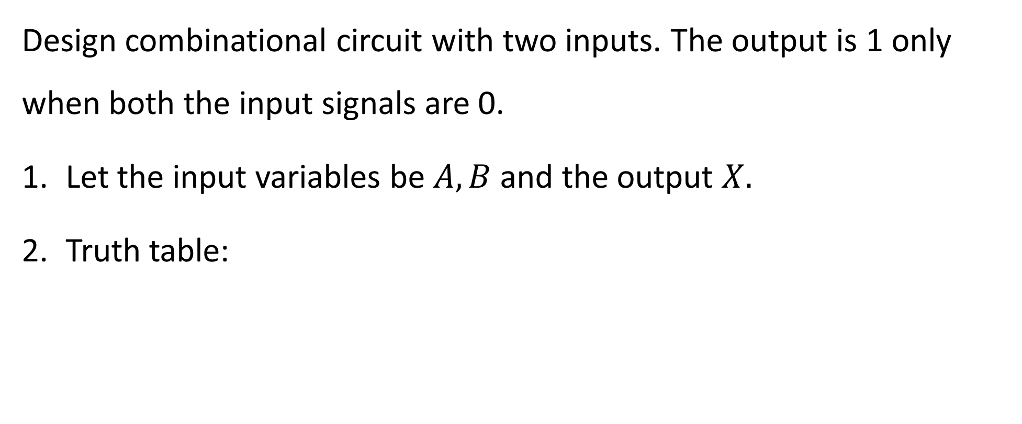
Sample 2
Combinational Circuits – Example
Design combinational circuit with two inputs. The output is 1 only when both the input signals are 0.
Let the input variables be $A, B$and the output $X.$
Truth table:
A | B | X
0 | 0 | 1
0 | 1 | 0
1 | 0 | 0
1 | 1 | 0

Slide 8
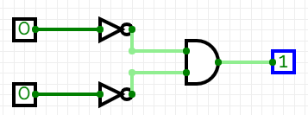

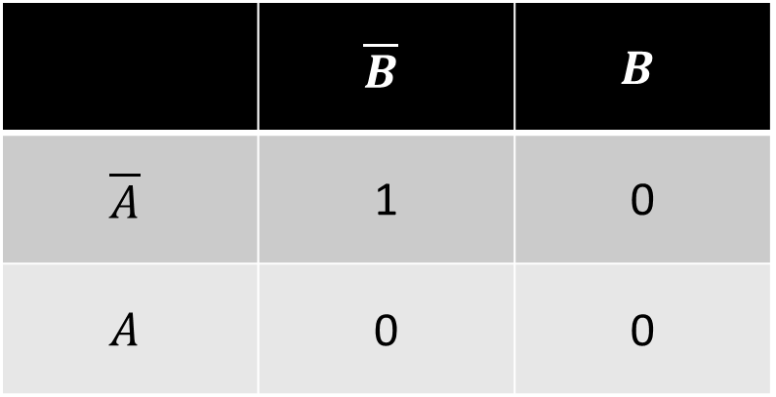
Sample 2
Combinational Circuits – Example
Karnaugh Map $X=\overline{A}.\overline{B}$
Logic diagram
 | $$\overline{B}$$ | $$B$$
$$\overline{A}$$ | 1 | 0
$$A$$ | 0 | 0

Slide 9
Sample 2
Combinational Circuits – Example
You have an underground water tank and a water tank at the roof top. You have also installed UPS for power outages. You have a mechanical sensor in the top tank, which tells whether the water level is below a certain level or not. A similar sensor is installed in the underground tank which tells whether the water level is above a certain level or not.
The switch to motor pump turns on automatically if the water level is below the marked level in top tank and above the marked level in the underground tank.
Additionally, there is a power supply sensor which tells whether the house is currently running on main power or UPS. If the UPS is being used, then the motor will not turn on, as it will not get enough wattage.
Design a combinational circuit to represent this scenario as Boolean logic.

Slide 10
Sample 2
Activity 2
You have an underground water tank and a water tank at the roof top. You have also installed UPS for power outages. You have a mechanical sensor in the top tank, which tells whether the water level is below a certain level or not. A similar sensor is installed in the underground tank which tells whether the water level is above a certain level or not.
The switch to motor pump turns on automatically if the water level is below the marked level in top tank and above the marked level in the underground tank.
Additionally, there is a power supply sensor which tells whether the house is currently running on main power or UPS. If the UPS is being used, then the motor will not turn on, as it will not get enough wattage.
You have also installed Solar panels at your house. Therefore, it is now possible to run the motor pump during day time even when the house is running on UPS.
Redesign the solution, catering for this new condition.

Slide 11
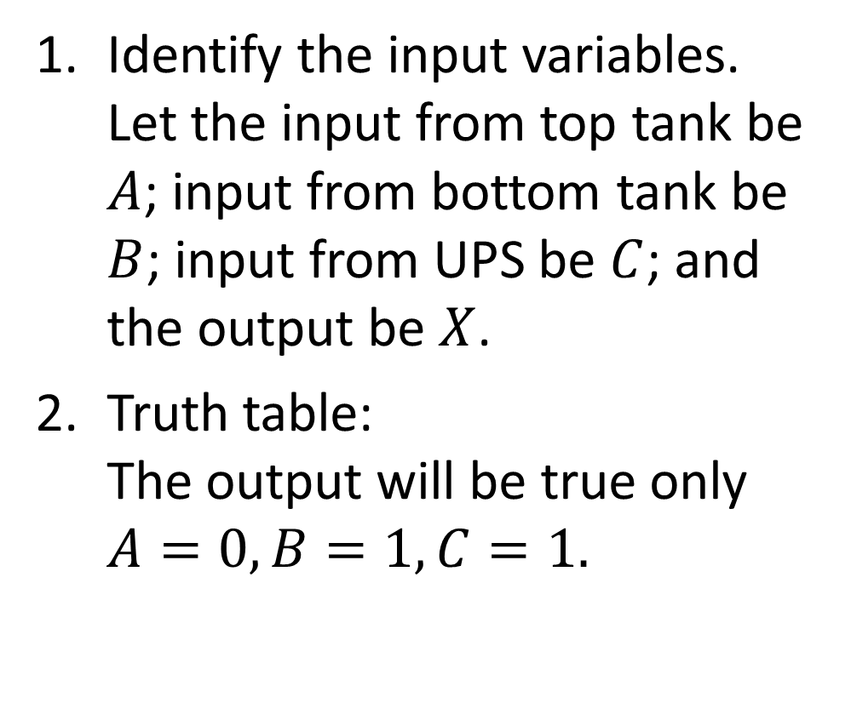
Sample 2
Combinational Circuits – Example
Identify the input variables. Let the input from top tank be $A$; input from bottom tank be $B$; input from UPS be $C$; and the output be $X$.
Truth table: The output will be true only $A=0,B=1,C=1$
A | B | C | X
0 | 0 | 0 | 0
0 | 0 | 1 | 0
0 | 1 | 0 | 0
0 | 1 | 1 | 1
1 | 0 | 0 | 0
1 | 0 | 1 | 0
1 | 1 | 0 | 0
1 | 1 | 1 | 0

Slide 12
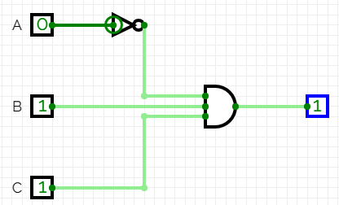
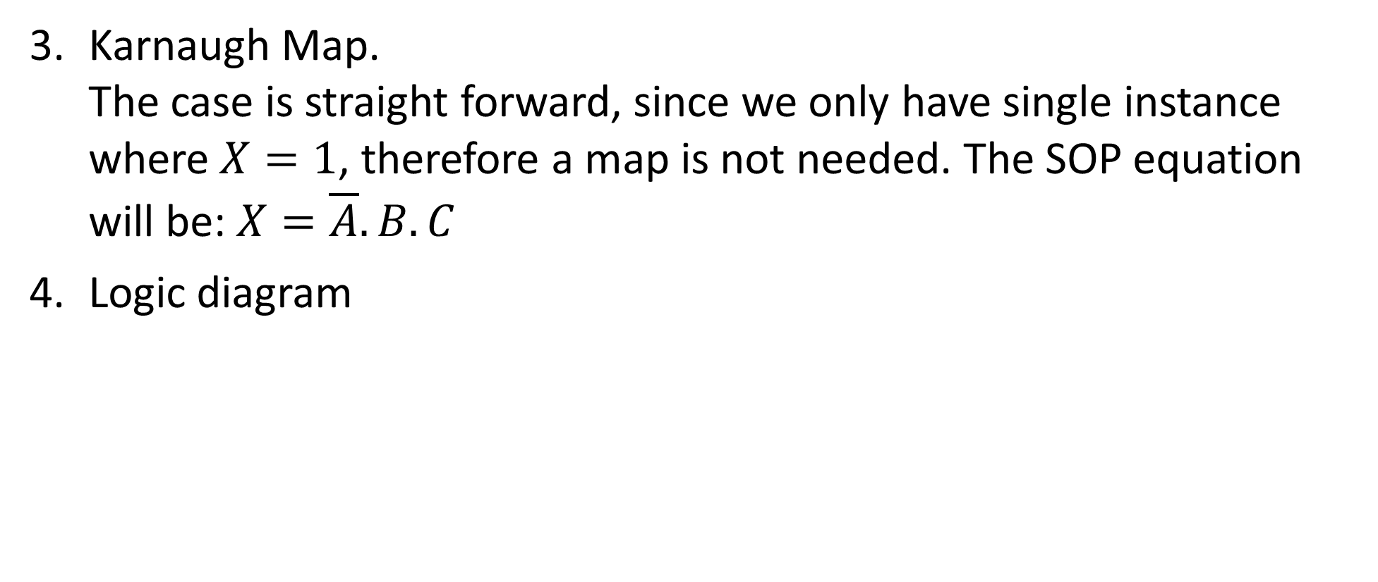
Sample 2
Combinational Circuits – Example
Karnaugh Map. The case is straight forward, since we only have single instance where $X=1$, therefore a map is not needed. The SOP equation will be: $X=\overline{A}.B.C$
Logic diagram

Slide 13
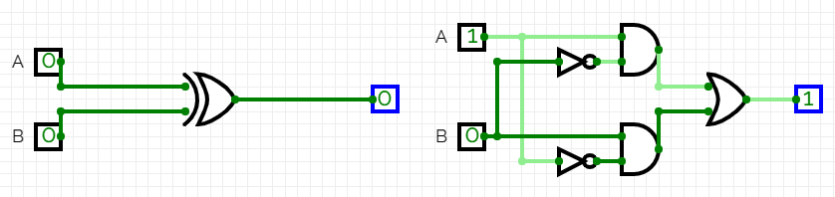
Sample 2
Exclusive Gates
Exclusive OR: Any, but not All
Exclusive AND: All, but not Any

Slide 14
Sample 2
Gate Conversions
Any Boolean circuit can be constructed using:
3 main gates: AND, OR, NOT
NAND gates
NOR gates
Which means all three of the above can be converted into one another.
One rule to remember is that two NOT gates cancel each other. Similarly, you can introduce two NOT gates, without affecting the output.

Slide 15
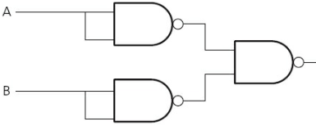
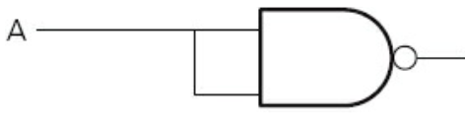

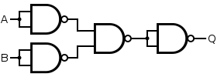
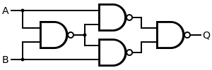
Sample 2
Gate Conversions
NAND as Universal gate
NOT
AND
OR
NOR
XOR
Notes:
Using NAND as universal gate is a business decision, which helps chip manufacturers to get a single chip in bulk and use it for any purpose without worrying about supply and demand gap.

Slide 16
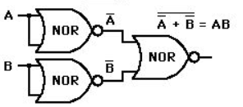


Sample 2
Gate Conversions
NOR as Universal gate
NOT
AND
OR

Slide 17

Sample 2
Gate Conversions
Create logic diagram and convert into NAND equivalent: $Q=A+\overline{B}C$
Convert the same into NOR equivalent

Slide 18



THANK YOU
Owais Hussain
+92 345-3174270
owais.hussain@kiet.edu.pk
https://www.researchgate.net/profile/Owais-Hussain-3

